Slide 1
CSD (CANONICAL SIGNED DIGIT) BASED LOW POWER FIR FILTER DESIGN
Tools Used: Xilinx ISE Design Suite 12.3
MATLAB fdatool

Slide 2
Mentor: Prof. R. Dwivedi
Students:
(08105EN063) Mukul Sharma
(08105EN064) Gaurav Verma
(08105EN069) Ajit Singh Songara

Slide 3
Problem Description
Digital filters contain a great number of constant coefficient multipliers
Multipliers can be optimized by using CSD-encoding (Canonical Signed Digit) for low power/high performance.
Design 2 filter versions, one using 2’s complemented form and the other using CSD encoded coefficients, and compare their performance

Slide 4
Tasks
Literature study of CSD-encoding.
Define a case; a filter with coefficient sets that shall be tested.
Develop CSD-encoding for the coefficient sets, code them in VHDL modules and test them through simulation.
Implementation of CSD-encoding based filter on FPGA.

Slide 5
Canonical Signed Digit
The Canonical Signed Digit (CSD) number system is a signed digit number system that minimizes the number of non-zero digits.
This can be used to reduce the number of adds in a logic circuit.
The digit set is ternary and each digit can be either -1, 0. or +1.
CSD digits that are beside each other are never both = 1. This implies that for an n-bit number, there are at most [n/2] non-zero digits.

Slide 6
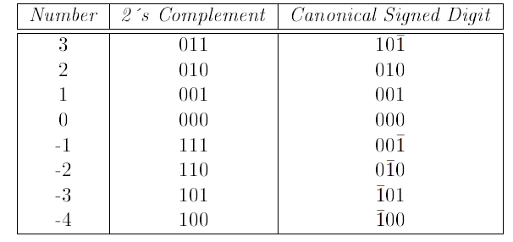
Table : Three Digit Canonical Signed Digit Numbers

Slide 7
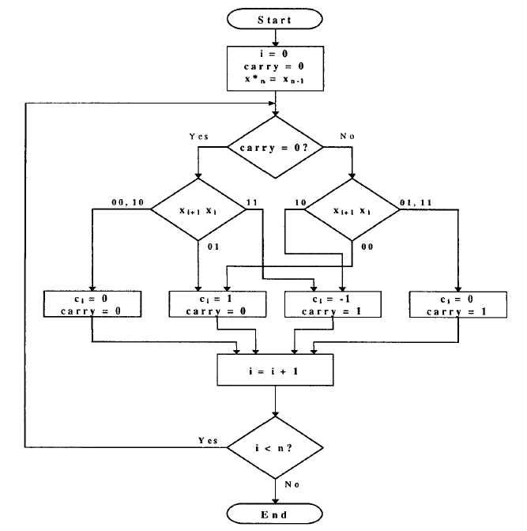
Binary to CSD Algorithm

Slide 8
Digital Filters
In a circuit one often wants to remove noise or extract useful parts of a signal.
To do this one uses filters. There are two kinds of filters, digital and analog.
Analog are built up by resistors, capacitors and op-amps. Analog filters are mathematically modeled using ordinary differential equations of Laplace transforms. They are analyzed in the time of Laplace domain.
Digital filters perform numerical calculations on sampled values of a signal.

Slide 9
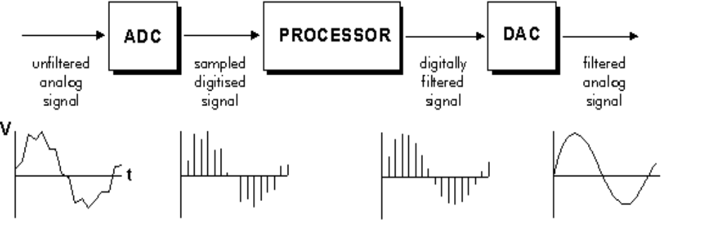
Fig. : Basic setup of a digital filter

Slide 10
Pros and Cons of Digital Filters
+ Digital filters can realize characteristics that is not so easily done by analog filters
+ Digital filters have the potential to attain a much better signal-to-noise ratio.
+ Digital filters are much easier to design, test and implement than an analog filter.
+ Digital filters can handle low frequency signals accurately
- Digital storage and computation limitations will give deterministic quantization errors after the ADC stage.

Slide 11
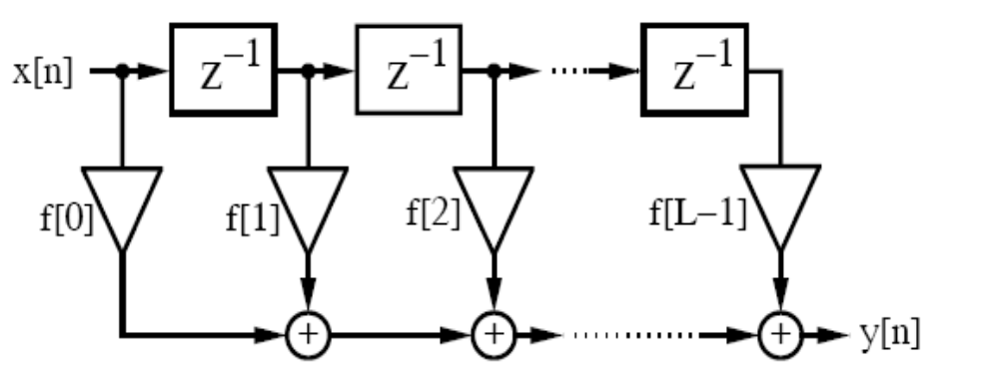
Direct Form Filter
Fig. : Direct form FIR filter

Slide 12


For an LTI (linear time invariant) FIR filter,

Slide 13
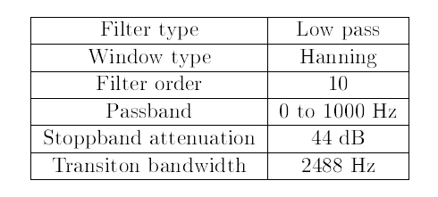
Filter Characteristics

Slide 14
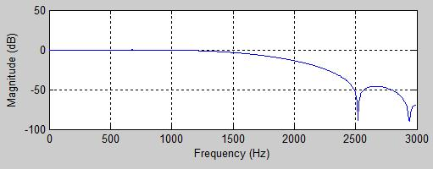
Frequency Response of the designed filter
at Fs = 6000 HZ

Slide 15
Digital Filter Coefficients
k | h(k)
0 | 0.002437094
1 | 0.013715162
2 | -0.044250023
3 | -0.044364337
4 | 0.28976238
5 | 0.5575594
6 | 0.28976238
7 | -0.044364337
8 | -0.044250023
9 | 0.013715162
10 | 0.002437094

Slide 16
Up-scaled and Coded coefficients: CSD based
k | h(k) | h(k) scaled | h(k) rounded | h(k), 16 bit CSD encoded
0 | 0.002437094 | 24.37094 | 24 | 000000000010Ῑ000
1 | 0.013715162 | 137.15162 | 137 | 0000000010001001
2 | -0.044250023 | -442.50023 | -443 | 000000Ῑ001000101
3 | -0.044364337 | -443.64337 | -444 | 000000Ῑ001000100
4 | 0.28976238 | 2897.6238 | 2898 | 000Ῑ0Ῑ0101010010
5 | 0.5575594 | 5575.594 | 5576 | 0010Ῑ0Ῑ001001000
6 | 0.28976238 | 2897.6238 | 2898 | 00010Ῑ0Ῑ01010010
7 | -0.044364337 | -443.64337 | -444 | 000000Ῑ001000100
8 | -0.044250023 | -442.50023 | -443 | 000000Ῑ001000101
9 | 0.013715162 | 137.15162 | 137 | 0000000010001001
10 | 0.002437094 | 24.37094 | 24 | 000000000010Ῑ000

Slide 17
Up-scaled and Coded coefficients: 2’s complement form
k | h(k) | h(k) scaled | h(k) rounded | h(k), 16 bit 2’s comp. encoded
0 | 0.002437094 | 24.37094 | 24 | 0000000000011000
1 | 0.013715162 | 137.15162 | 137 | 0000000010001001
2 | -0.044250023 | -442.50023 | -443 | 1111111001000101
3 | -0.044364337 | -443.64337 | -444 | 1111111001000100
4 | 0.28976238 | 2897.6238 | 2898 | 0000101101010010
5 | 0.5575594 | 5575.594 | 5576 | 0001010111001000
6 | 0.28976238 | 2897.6238 | 2898 | 0000101101010010
7 | -0.044364337 | -443.64337 | -444 | 1111111001000100
8 | -0.044250023 | -442.50023 | -443 | 1111111001000101
9 | 0.013715162 | 137.15162 | 137 | 0000000010001001
10 | 0.002437094 | 24.37094 | 24 | 0000000000011000

Slide 18
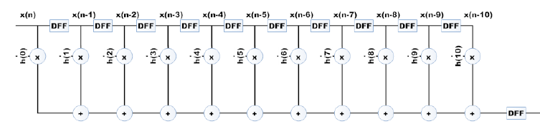
Filter Schematic Diagram

Slide 19
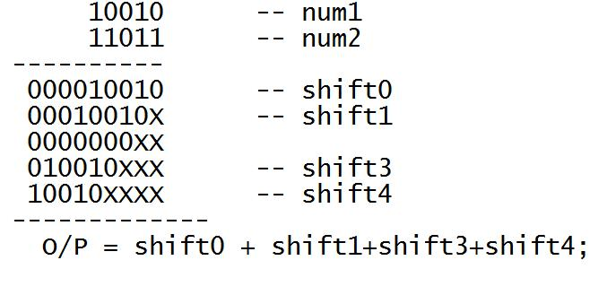
Mult. And Addn.

Slide 20
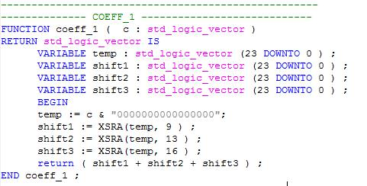
Function Snippet

Slide 21
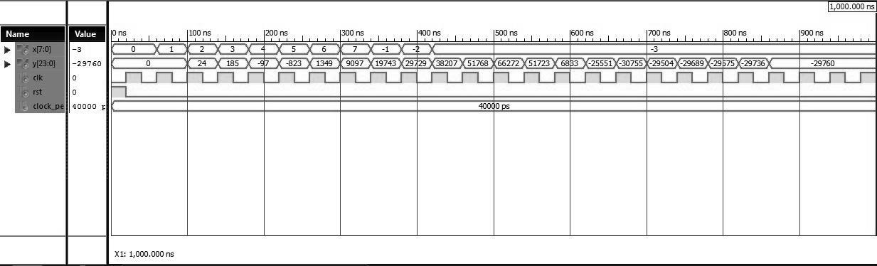
Simulation

Slide 22
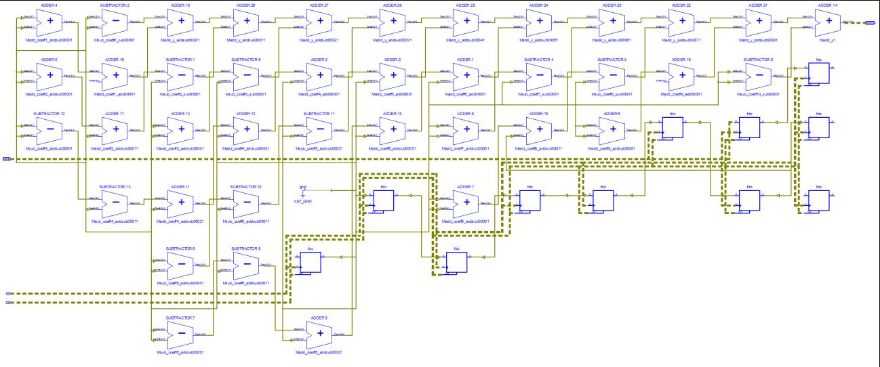
RTL Schematic at Signal Level

Slide 23
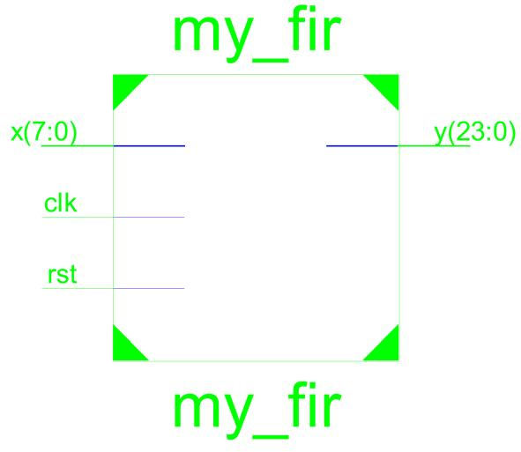
Schematic at Port Level

Slide 24
Comparison of the two designed filters
Parameter | 2’s Complement | CSD Encoded
Maximum output required time after clock | 49.573ns | 38.687ns
Number of Slice Flip Flops | 103 out of 9,312 1% | 93 out of 9,312 1%
Number of 4 input LUTs | 747 out of 9,312 8% | 635 out of 9,312 6%
Power Consumption (in mW, at a clock of 40ns) | 102.53 | 101.33

Slide 25
THANK YOU

